Slide 1
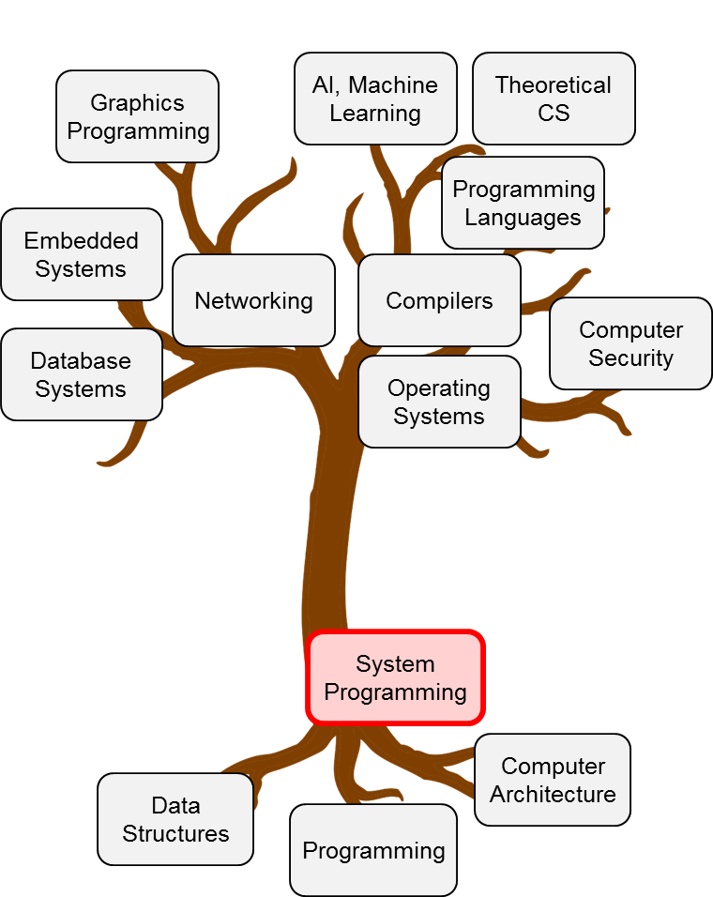
C Programming Examples

Slide 2
Goals of this Lecture
Learn from two C code examples
Simple character processing programs
Dealing with ASCII code
Making the code readable & portable
Named constants
Comments
Building C programs
Preprocessing
Compiling
Assembling
Linking

Slide 3
C Example Code #1
Read the characters from the standard input (by default, keyboard). Print the number of English alphabets (‘a’ .. ‘z’, ‘A’..’B’) and the number of digits (‘0’..’9’) from the input string.
The source code file is count.c.
$ gcc800 –o count count.c
$ ./count < count.c
# of alphabets: 253
# of digits: 4
# of other characters: 289
< redirects the file content to stdin

Slide 4

#include <stdio.h>
int main(void)
{ //EOF == (int)-1 == 0XFFFFFFFF
int c;
int alphaCount = 0;
int digitCount = 0;
int othersCount = 0;
while ((c = getchar()) != EOF) {
if ((c >= 97 && c <= 122) || (c >= 65 && c <= 90))
alphaCount++;
else if (c >= 48 && c <= 57)
digitCount++;
else
othersCount++;
}
printf("# of alphabets: %d\n", alphaCount);
printf("# of digits: %d\n", digitCount);
printf("# of other characters: %d\n", othersCount);
return 0;
}
Why int (4 bytes) for 1 byte char?

Slide 5
#include <stdio.h>
int main(void)
{
int c;
int alphaCount = 0;
int digitCount = 0;
int othersCount = 0;
while ((c = getchar()) != EOF) {
if ((c >= 97 && c <= 122) || (c >= 65 && c <= 90))
alphaCount++;
else if (c >= 48 && c <= 57)
digitCount++;
else
othersCount++;
}
printf("# of alphabets: %d\n", alphaCount);
printf("# of digits: %d\n", digitCount);
printf("# of other characters: %d\n", othersCount);
return 0;
}
How is character compared to number? ASCII code!

Slide 6
ASCII: a Popular Character Set
American Standard Code for Information Interchange
0 1 2 3 4 5 6 7 8 9 10 11 12 13 14 15
0 NUL SOH STX ETX EOT ENQ ACK BEL BS HT LF VT FF CR SO SI
16 DLE DC1 DC2 DC3 DC4 NAK SYN ETB CAN EM SUB ESC FS GS RS US
32 SP ! " # $ % & ' ( ) * + , - . /
48 0 1 2 3 4 5 6 7 8 9 : ; < = > ?
64 @ A B C D E F G H I J K L M N O
80 P Q R S T U V W X Y Z [ \ ] ^ _
96 ` a b c d e f g h i j k l m n o
112 p q r s t u v w x y z { | } ~ DEL
Digit (‘0’ .. ‘9’): 48 – 57
Lower case alphabet (‘a’..’z’): 97-122
Upper case alphabet (‘A’..’Z’): 65-90
Extended character set: 128-255

Slide 7
Program using ASCII characteristics
Warning: this code is ugly and unreadable – just here for educational purposes
What is the output like?
#include <stdio.h>
int main(void)
{
printf(“characters: %c %c %c\n”, 97, ‘a’ + 3, 122);
printf(“characters: %c %c\n”, ‘C’ + ‘a’ – ‘A’, ‘c’ – (‘a’ – ‘A’));
return 0;
}

Slide 8
Program using ASCII characteristics
Warning: this code is ugly and unreadable – just here for educational purposes
What is the output like?
characters a d z
characters c C
97 = ‘a’, 122 = ‘z’
#include <stdio.h>
int main(void)
{
printf(“characters: %c %c %c\n”, 97, ‘a’ + 3, 122);
printf(“characters: %c %c\n”, ‘C’ + ‘a’ – ‘A’, ‘c’ – (‘a’ – ‘A’));
return 0;
}
What is this?
Notes:
In prior lectures, we discussed that numbers and characters can be used interchangeably within a single quote.

Slide 9
#include <stdio.h>
int main(void)
{
int c;
int alphaCount = 0;
int digitCount = 0;
int othersCount = 0;
while ((c = getchar()) != EOF) {
if ((c >= ‘a’ && c <= ‘z’) || (c >= ‘A’ && c <= ‘Z’))
alphaCount++;
else if (c >= ‘0’ && c <= ‘9’)
digitCount++;
else
othersCount++;
}
printf("# of alphabets: %d\n", alphaCount);
printf("# of digits: %d\n", digitCount);
printf("# of other characters: %d\n", othersCount);
return 0;
}
Better readability, but has dependency on ASCII code
Notes:
Based on what we’ve discussed so far, a better way of writing code for our example would be to replace the integer numbers of ASCII codes to the actual characters within single quote.
A remaining problem with this code however is that we are still assuming the input from standard input uses the ASCII code.
When different extended codes are used, this code will not behave as we originally intended it would be.

Slide 10
#include <stdio.h>
#include <ctype.h>
int main(void)
{
int c;
int alphaCount = 0;
int digitCount = 0;
int othersCount = 0;
while ((c = getchar()) != EOF) {
if (isalpha(c))
alphaCount++;
else if (isdigit(c))
digitCount++;
else
othersCount++;
}
printf("# of alphabets: %d\n", alphaCount);
printf("# of digits: %d\n", digitCount);
printf("# of other characters: %d\n", othersCount);
return 0;
}
C library functions that are neutral to the types of character set

Slide 11
C Example Code #2
Word counting: count the number of words with the input from stdin
A word = a sequence of non-space characters:
space character: ‘ ‘, ‘\t’, ’\n’, etc.
e.g., “I am a boy”: 4 words (“I”, “am”, “a”, “boy”)
How to approach? state tracking
state1: inside-a-word
state2: outside-a-word
# of words = number of the times when the program switches from state2 to state1
Notes:
The approach that we will take is as follows.
While we are reading the input characters, we keep track of which state we are currently in. There are two possible states, inside a word state and the outside a word state.
Here, the number of words can be derived by counting the number of times we transition from outside a word state to an inside a word state.

Slide 12
Deterministic Finite State Automata (DFA)
DFA consists of a finite number of states, transitions labeled by input characters and optional actions
Initial state is denoted by ‘➔’ from outer space
Final state (or accepting state) may exist (typically, double circled)
State transition diagram looks as follows
Non-space character
Non-space character
Action: nw = nw + 1
Outside
Word
Inside
Word
Space character
(‘ ‘, ‘\t’, ‘\n’)
Space character

Slide 13
More DFA Examples
Detecting “SNUCSE” in a stream of characters
Detecting an integer: 0 or [+-]?[1-9][0-9]*
[1-9] means 1 or 2 or …, 9
x* means zero or more repetition of character x
x? means zero or one repetition of character x
S
N
U
C
S
E
F
S
1
2
3
4
5
F
Any letter
but K
N
1-9
0-9
S
+/-
1
1-9
F
0
F

Slide 14
#include <stdio.h>
#include <ctype.h>
int main(void)
{
int c, nWords = 0, state = 1;
while ((c = getchar()) != EOF) {
switch (state) {
case 0:
if (isspace(c)) state = 1;
break;
case 1:
if (!isspace (c)) { state = 0; nWords++;}
break;
}
}
printf("# of words: %d\n", nWords);
return 0;
}
0, 1 are magic numbers: use named constants!

Slide 15
3 Ways to Represent Named Constants
enum VarName {CONST1, CONST2, …};
enum DFAState {IN, OUT};
IN starts with 0 and OUT = (IN + 1) = 1
#define ConstName value
“ConstName” is replaced by “value” at preprocessing
#define IN 0
#define OUT 1
const int ConstName = value;
const int IN = 0;
const int OUT = 1;

Slide 16
#include <stdio.h>
#include <ctype.h>
enum DFAState {IN, OUT};
int main(void)
{
int c, nWords = 0;
enum DFAState state = OUT;
while ((c = getchar()) != EOF) {
switch (state) {
case IN:
if (isspace(c)) state = OUT;
break;
case OUT:
if (!isspace (c)) { state = IN; nWords++;}
break;
}
}
printf("# of words: %d\n", nWords);
return 0;
}
Anything missing?
Comment on the main function
default case in switch

Slide 17
#include <stdio.h>
#include <ctype.h>
#include <assert.h>
enum DFAState {IN, OUT};
/* count and print the number of words in input */
int main(void)
{
int c, nWords = 0; enum DFAState state = OUT;
while ((c = getchar()) != EOF) {
switch (state) {
case IN:
if (isspace(c)) state = OUT;
break;
case OUT:
if (!isspace (c)) { state = IN; nWords++;}
break;
default:
assert(0); /* error */
break;
}
}
printf("# of words: %d\n", nWords);
return 0;
}
Comment should focus on “what” instead of “how”
Defensive programming: guard against an error case where
state != IN && state != OUT
Notes:
Here is a modified version of our code.

Slide 18
Comment on Function
Write comment on each function
Required for a good grade for system programming
Bad function-level comment: describes how
It reads a character from stdin and checks if it’s a non-space character. If so, the program state moves to state “IN” and increment the counter. If it’s a space character, the state moves to OUT. It keeps on reading the input until EOF and prints out the word counter
Good function-level comment: describes what
Count the number of words in input from stdin and print it out
Much simpler and easy to understand/maintain

Slide 19
C Example #2 Summary
Design an algorithm before writing code
It should reduce complexity
Current state + input char = next state + output
Improve code readability
Avoid magic numbers
Named constants are useful (enum, #define, const)
Comments and defensive programming
Function-level comments focus on what
Intra-function comments typically explain individual code lines
Defensive programming is desirable
It would greatly reduce debugging time

Slide 20
Building a C Program
hello.c
Compile and execute hello.c
Source code
C language
Contains preprocessor directives
#include <stdio.h>
int main(void)
{
/* Write "hello, world\n" to stdout. */
printf("hello, world\n");
return 0;
}
ubuntu:~$ gcc800 hello.c -o hello
ubuntu:~$ ./hello
hello, world
gcc800 is a script that executes
gcc -Wall -Werror -ansi -pedantic -std=c99

Slide 21
Steps to Make Executable File
Shortcut
hello.c
hello
gcc800 hello.c -o hello
C Preprocessor
Linker
gcc800 -E hello.c > hello.i
gcc800 hello.o -lc -o hello
hello.i
hello.o
libc.a
C Compiler
C Assembler
gcc800 -S hello.i
hello.s
gcc800 -c hello.s

Slide 22
Preprocess C Code
hello.i
C Preprocessor
gcc800 -E hello.c > hello.i
Source code
C language
Contains declaration of printf() function
Missing definition of printf() function
Remove comments
…
int printf(char *format, …);
…
int main(void)
{
printf("hello, world\n");
return 0;
}

Slide 23
Compile Assembly Language
hello.s
C Compiler
Source code
Assembly language specific to computer architecture
Missing definition of printf() function
gcc800 -S hello.i
.section .rodata
cGreeting:
.asciz "hello, world\n"
.section .text
.global main
.type main, @function
main:
puchl %ebp
movl %esp, %ebp
pushl %cGreeting
call printf
addl $4, $esp
movl $0, %eax
movl %ebp, %esp
popl %ebp
ret

Slide 24
Generate Object File
hello.o
C Assembler
gcc800 -c hello.s
Object file
Machine language
Unreadable by human
Missing definition of printf() function
libc.a = library containing machine language definition of printf() function (and many others)
… 100101000110100100100 …

Slide 25

Generate Executable Binary
hello.o
…100101000110100100100…
Executable
Machine language
libc.a = library containing machine language definition of printf() function (and many others)
libc.a
…11100100000100100110…
Linker
gcc800 hello.o -lc -o hello
hello
kyoungsoo93@mypc:~$ ./hello
hello, world

Slide 26
Shortcut of All Processes
Shortcut
hello.c
hello
gcc800 hello.c -o hello
C Preprocessor
Linker
gcc800 -E hello.c > hello.i
gcc800 hello.o -lc -o hello
hello.i
hello.o
libc.a
C Compiler
C Assembler
gcc800 -S hello.i
hello.s
gcc800 -c hello.s

Slide 27
gcc800 vs. gcc?
gcc800 is a special script made for this course
Script: a text file that contains commands to execute a series of tasks
gcc800 adds a number of options to catch improper programming
e.g. warns unused variable, use variable without initializing it, etc.
You can make this script by yourself using vscode editor (or whatever you like)
$ emacs gcc800
Do these on your own machine (Lab machines are already set up properly)
Make this script executable:
$chmod +x gcc800
Move this file to folder that can be accessed globally
$sudo mv gcc800 /usr/bin/gcc800
#!/bin/bash
gcc -Wall -Werror -ansi -pedantic -std=c99 "$@"

